Slide 1
Personal Assistant rover(Chitti)
Santhosh nagendran
Kunalsinh Gohil
Sankeerth reddy dargula

Slide 2
Introduction
We have developed a rover which is used for the personal assistance.
Our idea is to concentrate on solutions for the real world problems such as,
Physically challenged people find it difficult to do their own work.
Bedridden people are not able to their own work, they need personal assistant or some other person to do their work.
People find it difficult to lift heavy objects and routine works in the factories and warehouses.
Bomb squad have to go to the field in person to diffuse the bomb which is really risky.

Slide 3
components used
Controller – Atmega2568, Atmega328P(Arduino Mega & Nano).
Pixy2Camera module.
Ultrasonic sensor.
HC-05 Bluetooth module.
L293D - Two DC motor driver.
12V DC motor(2).
6V High torque servo motors(4).
12V to 6V DC-DC buck converter.
MicroSD card module.
8 Ohms speaker.
12V 3.2Ah lead acid battery.
5V 10000mAh Battery.
RF transmitter & receiver.
Voice recognition module + Microphone.
LM386 Audio amplifier.

Slide 4
Features of Chitti
Chitti can be operated in two modes,
Manual mode.
Automatic mode.
Some of the interactive features with the user are,
It can move – it has the DC motor to move front, back, left and right.
It can lift – it has got a servo motor installed 4 axis arm for lifting an object.
It can see – it has got a camera to make the autonomous operation work and avoid obstacles.
It can hear – it has got microphone to listen to the user’s instructions.
It can speak – it has a speaker installed to give pre stored voice commands to the users.

Slide 5
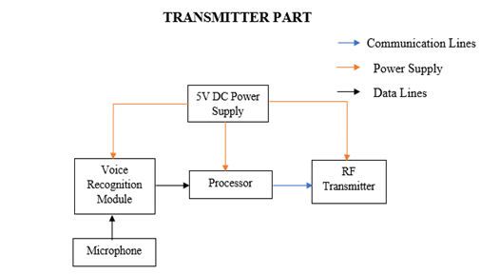
Block Diagram-Transmitter

Slide 6
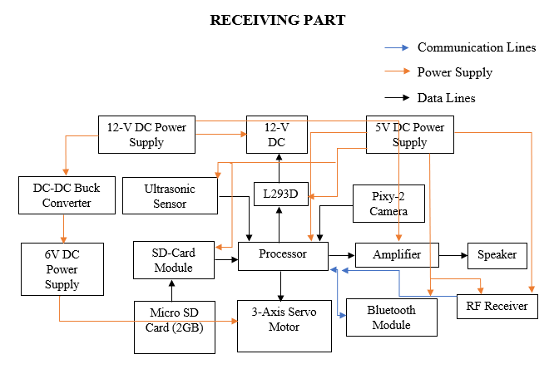
Block Diagram-Receiver

Slide 7
Process Involved
We spent quite a time to finalize our project’s concept.
We were researching about the components selection.
The shipping period of the components were used wisely by writing some codes to test each of the components while they arrive in.
Testing of all the components individually was successful.
A small checklist has been developed for interfacing corresponding modules.
We faced many hurdles throughout the process.
We came across alternative solutions to resolve the problems with proper research & guidance.

Slide 8
Problems / solution
Mechanical arrangement of chassis – issues with right turn. (Partially solved)
Robotic arm power issue – DC to DC buck converter. (Solved)
Speech instructions – audio amplifier. (Solved)
Voice recognition – RF transceiver. (Solved)
Interface issue – timer change. (Solved)
Switching modes – power issues. (Unsolved)

Slide 9
Thank you

